Slide 1




BUILDING DRAWING Final Project
Name : Apoorv Shukla
Roll No : CE22B006

Slide 2
BYELAWS – (Greater Noida , UP)
Minimum size of plots for residential buildings. –
No construction of a residential building shall be permitted on any plot area which is less than 125 sq. mtrs. and which has a width less than 6 mtrs.
Actual Plot Area Taken : 495sq. mtrs
Living room. –
No living or sleeping room shall have a carpet area less than 9.5 sq. mtrs. and the minimum width of such room shall be 2.4 mtrs.
Actual Living Room Area Taken : 17.98 sq. mtrs (width=3.54 mtrs)
Kitchen. –
The area should not be less than 5.0 sq. mtrs. with a minimum width of 1.8 sq. mtrs. where there is a separate store, the size of the kitchen may be reduced to 4.5 sq. mtrs.
Actual Kitchen Area Taken : 10.18 sq. mtrs (width=2.86 mtrs)

Slide 3
Bathroom and water closets. –
The size of the bathrooms shall not be less than 1.44 sq. mtrs. with minimum width of 1.2 mtrs. The minimum carpet area for water closet shall be 1.08 sq. mtrs. with a minimum width of 0.9 mtr.
Actual Bathroom Area Taken : 4.15 sq. mtrs (minimum) (width=1.76 mtrs)
Store Room. –
The area of a store room shall not be less than 2.0 sq. mtrs. However, in case of residential building the maximum area thereof shall not exceed 7.00 sq. mtrs.
Actual Storeroom Area Taken : 2.43 sq. mtrs

Slide 4
Plot size used : 495 sq meters
FAR / FSI maximum : 130
Maximum Height allowed : 15m
Actual Height used : 7.16m
Ground Floor Coverage : 55% (max allowed = 272 sq meters )
Actual Ground Floor Coverage : 226.25 sq meters
First Floor Coverage : 50% (max allowed = 325 sq meters )
Actual Ground Floor Coverage : 226.25 sq meters
Total Area of Floor area allowed = (FAR x Plot area) / 100 = 130 x 495 / 100 = 643 sq meters
Total Area of Floors Actual = around 375 sq meters.
FSI =
Setbacks : (Allowed : Used)
Front : 4.5 m : 4.5m
Rear : 3 m : 3 m
Side : 3m : 3.66 m (max)

Slide 5
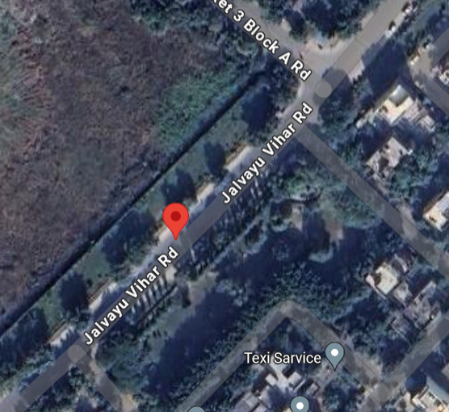
Location :
Jalvayu Vihar Road, Block-A
Greater Noida
Uttar Pradesh

Slide 6
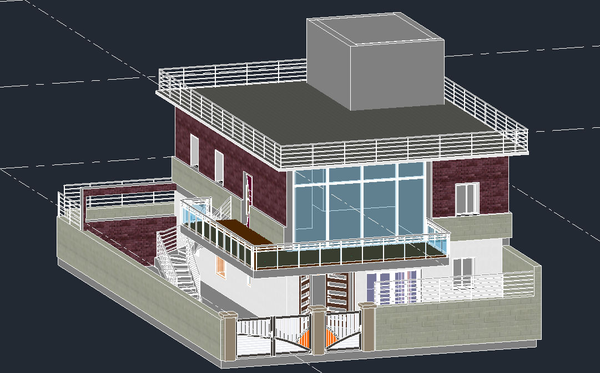

3D Model

Slide 7
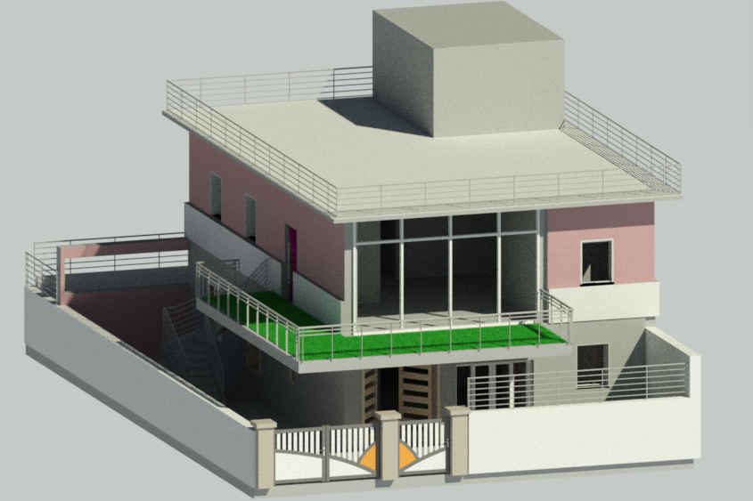
Render

Slide 8

Floor Plans

Slide 9
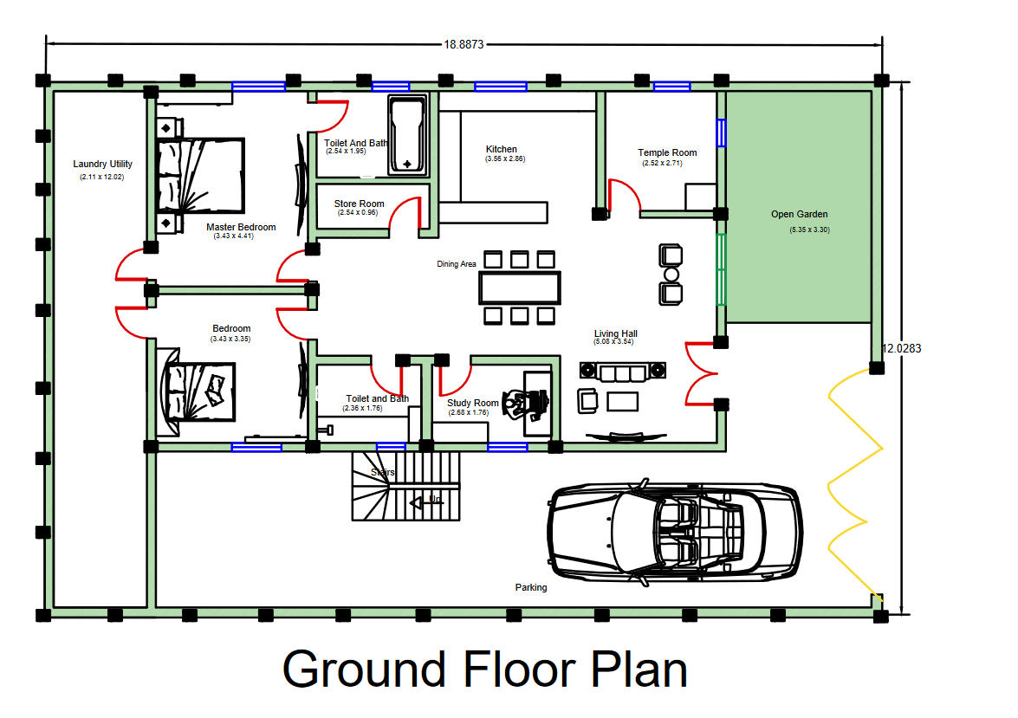

Slide 10
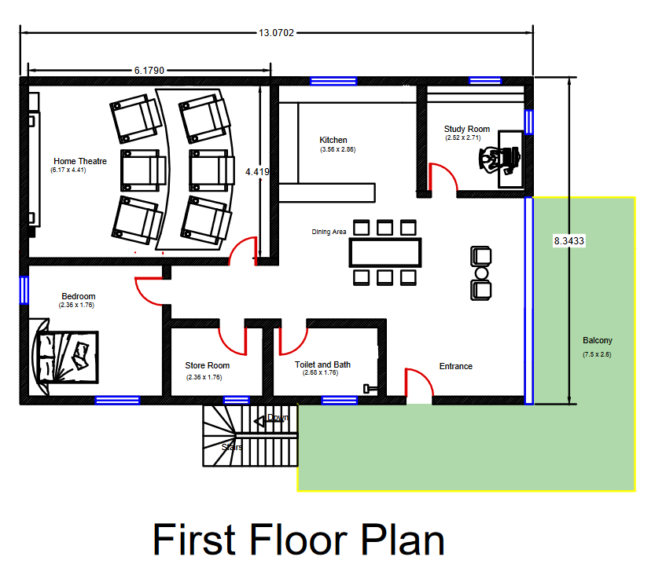

Slide 11
SITE PLAN

Slide 12
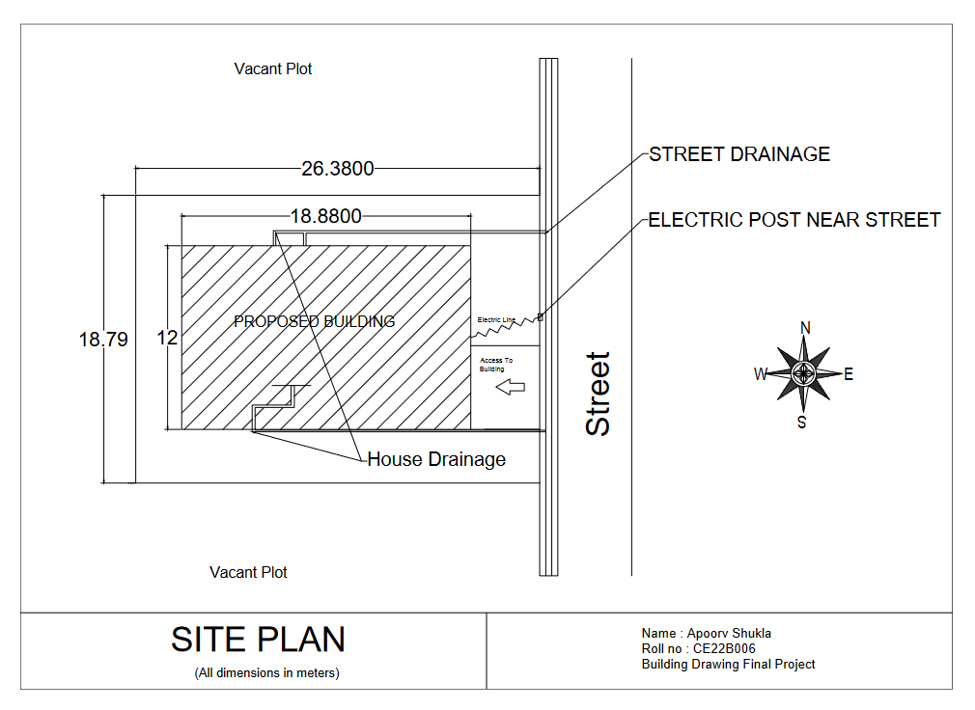

Slide 13
SECTION VIEW

Slide 14
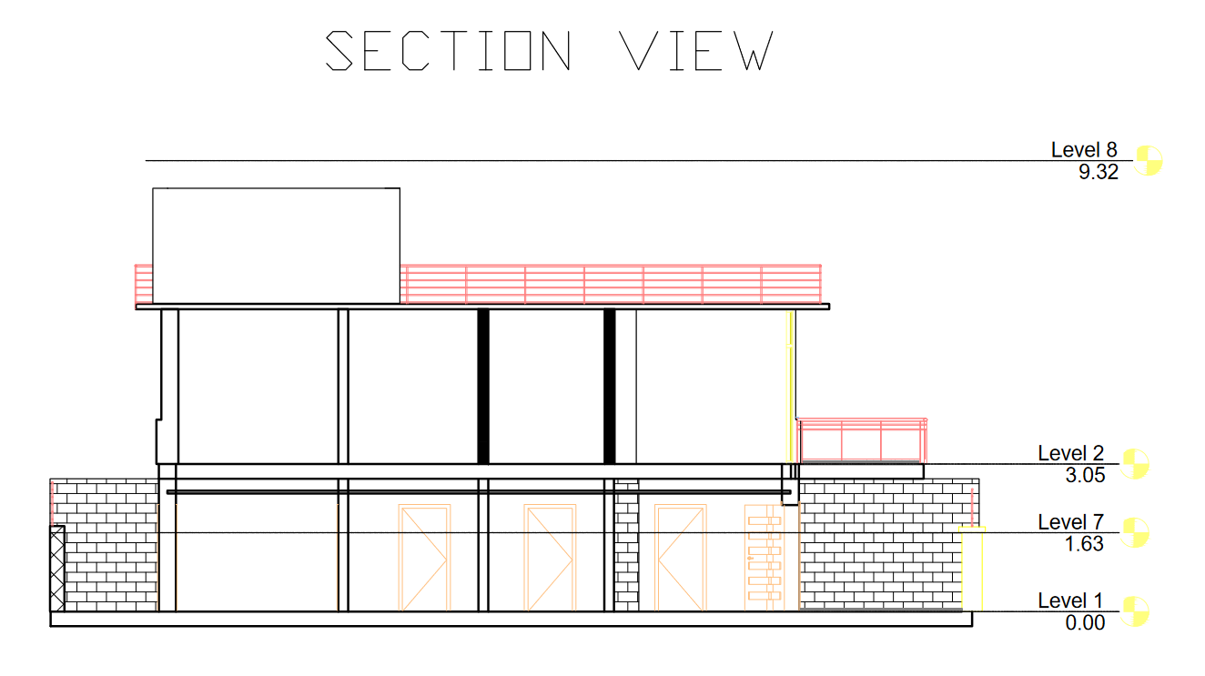

Slide 15
ELEVATIONS

Slide 16
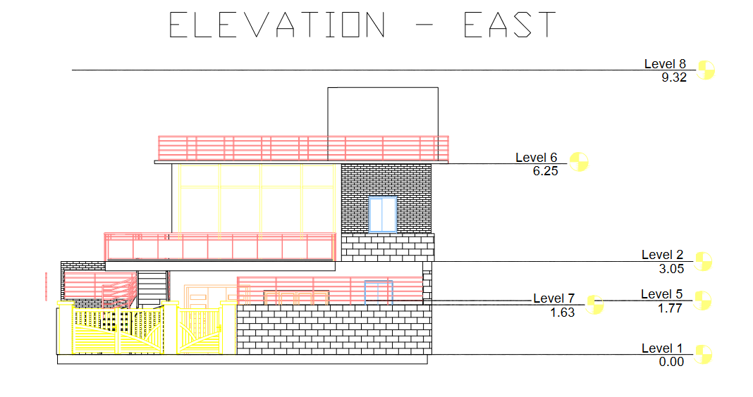

Slide 17
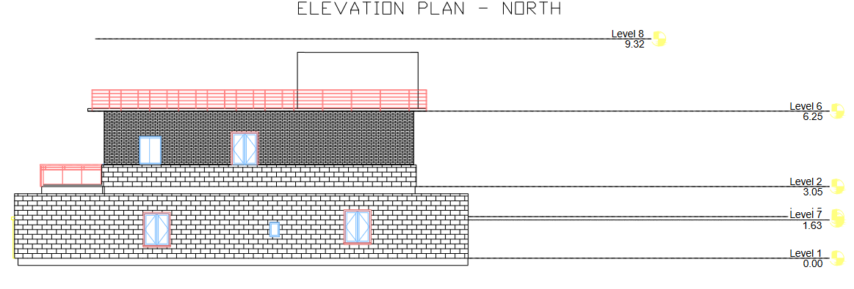

Slide 18
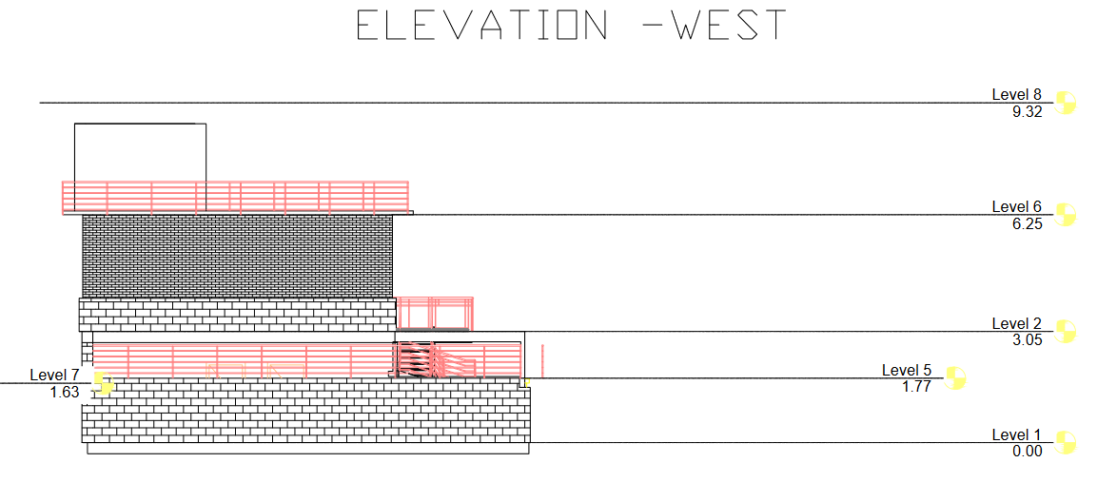

Slide 19
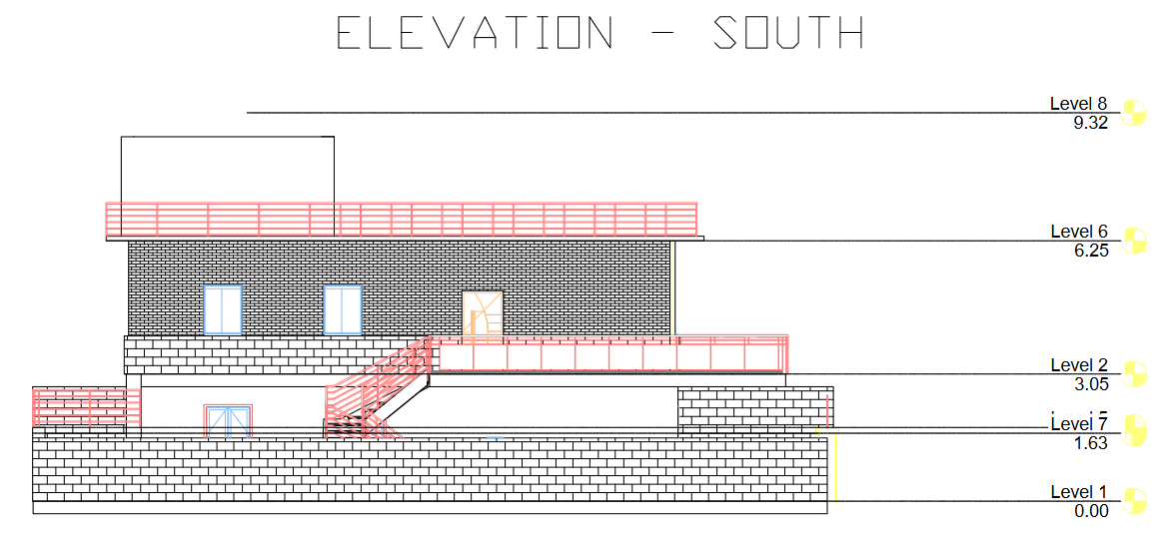

Slide 20

THANK YOU

